Slide 1
Subject: SOFTWARE ENGINEERING Subject Code: 3CS4-07 UNIT I: Introduction to Software Engineering Lecture-3: SDLC Models
GLOBAL INSTITUTE OF TECHNOLGY JAIPUR
Software Engineering
III SEM CS

Slide 2
INCREMENTAL MODEL
There are many situations in which initial software requirements are well defined, but it is not possible to follow a purely linear process.
In addition, there may be a need to provide a limited set of software functionality to users quickly and then refine and expand on that functionality in later software releases. In such cases, you can choose a process model that is designed to produce the software in increments.
The incremental model combines elements of linear and parallel process flows and applies linear sequences in a stepwise manner according to calendar. Each linear sequence produces deliverable “increments” of the software.

Slide 3
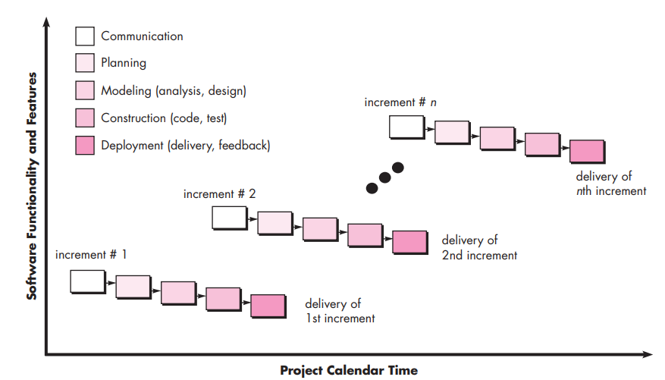

Slide 4
For example, word-processing software developed using the incremental model may deliver:
basic file management, editing, and document production functions in the first increment;
more sophisticated editing and document production capabilities in the second increment;
spelling and grammar checking in the third increment;
and advanced page layout capability in the fourth increment.
It should be noted that the process flow for any increment can incorporate the prototyping methods.

Slide 5
RAD (Rapid Application Development) Model
RAD is a linear sequential software development process model that emphasizes a concise development cycle using an element based construction approach. If the requirements are well understood and described, and the project scope is a constraint, the RAD process enables a development team to create a fully functional system within a concise time period.
RAD (Rapid Application Development) is a concept that products can be developed faster and of higher quality through:
Gathering requirements using workshops or focus groups
Prototyping and early, reiterative user testing of designs
The re-use of software components
A rigidly paced schedule that refers design improvements to the next product version
Less formality in reviews and other team communication

Slide 6
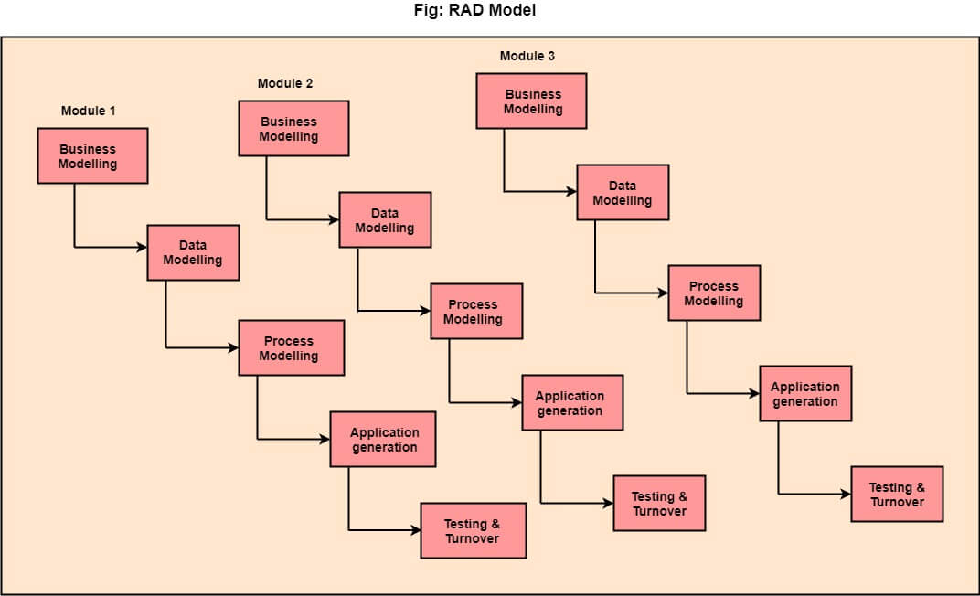

Slide 7
The various phases of RAD are as follows:
1.Business Modelling: The information flow among business functions is defined by answering questions like what data drives the business process, what data is generated, who generates it, where does the information go, who process it and so on.
2. Data Modelling: The data collected from business modeling is refined into a set of data objects (entities) that are needed to support the business. The attributes (character of each entity) are identified, and the relation between these data objects (entities) is defined.
3. Process Modelling: The information object defined in the data modeling phase are transformed to achieve the data flow necessary to implement a business function. Processing descriptions are created for adding, modifying, deleting, or retrieving a data object.
4. Application Generation: Automated tools are used to facilitate construction of the software; even they use the 4th GL techniques.
5. Testing & Turnover: Many of the programming components have already been tested since RAD emphasis reuse. This reduces the overall testing time. But the new part must be tested, and all interfaces must be fully exercised.

Slide 8
Agile Model
The meaning of Agile is swift or versatile."Agile process model" refers to a software development approach based on iterative development. Agile methods break tasks into smaller iterations, or parts do not directly involve long term planning. The project scope and requirements are laid down at the beginning of the development process. Plans regarding the number of iterations, the duration and the scope of each iteration are clearly defined in advance.
Each iteration is considered as a short time "frame" in the Agile process model, which typically lasts from one to four weeks. The division of the entire project into smaller parts helps to minimize the project risk and to reduce the overall project delivery time requirements. Each iteration involves a team working through a full software development life cycle including planning, requirements analysis, design, coding, and testing before a working product is demonstrated to the client.

Slide 9
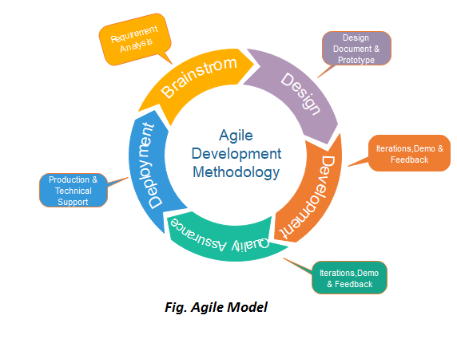

Slide 10
Phases of Agile Model:
Following are the phases in the Agile model are as follows:
Requirements gathering
Design the requirements
Construction/ iteration
Testing/ Quality assurance
Deployment
Feedback

Slide 11
When to use the Agile Model?
When frequent changes are required.
When a highly qualified and experienced team is available.
When a customer is ready to have a meeting with a software team all the time.
When project size is small.

Slide 12
Advantage(Pros) of Agile Method:
Frequent Delivery
Face-to-Face Communication with clients.
Efficient design and fulfils the business requirement.
Anytime changes are acceptable.
It reduces total development time.

Slide 13
Disadvantages(Cons) of Agile Model:
Due to the shortage of formal documents, it creates confusion and crucial decisions taken throughout various phases can be misinterpreted at any time by different team members.
Due to the lack of proper documentation, once the project completes and the developers allotted to another project, maintenance of the finished project can become a difficulty.

Slide 14
Advantages and Disadvantages of different Software Development Life Cycle Model
Waterfall Model
Advantages of Waterfall Model
Waterfall model is easy to use and understand.
Development processes go one-by-one.
It is easy to determine the key points of each development life cycle.
Best suited for small and medium sized project.
Follow simple management process due to the inflexibility.
Disadvantages of Waterfall Model
After the completion of last phase, the software will be ready to use.
High risk and uncertainty.
Not suited for large or complex projects
Progress of the development is difficult to measure or evaluate.

Slide 15
Spiral Model
Advantages of Spiral Model
Project development life cycle is divided into small parts, which can further divide the risk, and phases may have finished earlier to address the threats.
The development processes are effectively documented and highly scalable to adopt changes.
Earlier working prototype is done before user can point out the flaws into the system.
Disadvantages of Spiral Model
Project development can be expensive.
It requires experienced project developer to mitigate the risk effectively.
Spiral model not be considered for small sized project.
Some intermediate stages require excessive documentation.

Slide 16
The V-Model
Advantages of V-Shaped Model
Due to V-shape model, it has strict results and so easy to use and control.
Testing phases of modules take place in early stages of development.
V-shaped model can effectively be used for small projects, where requirements are clear and static.
Disadvantages of V-Shaped Model
V-shaped model has lack of flexibility.
Risk can be associated.
Not very good for large size

Slide 17
Iterative Models
Advantages of Iterative Model
Some of the initial functions may execute quickly at the beginning of the project.
Progress of the project is measurable.
Because of the shorter iteration process, testing and reviewing processes are easy to cover.
Flexibility to adopt the changes into the requirements of the project.
Disadvantages of Iterative Model
This model requires more resources than the waterfall model.
It has some issues with architecture design of project during the short planning stage.
It is not suitable for small sized project.
The development processes are difficult to manage.

Slide 18
Thank You!

